Slide 1

WEB TECHNOLOGIES
CSS – Cascading Style Sheet
and Selectors
Vinay Joshi
Department of
Computer Science and Engineering

Slide 2
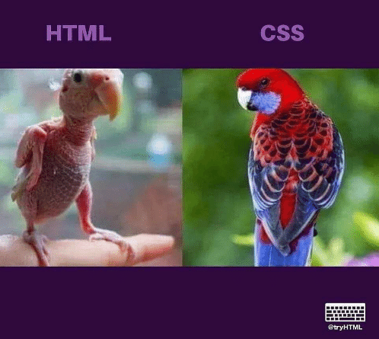
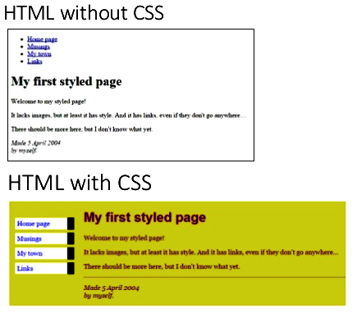
CSS – Cascading Style Sheets and Selectors
Introduction

Slide 3

Cascading Style Sheets
The CSS1 specification was developed in 1996
CSS2 was released in 1998
CSS3 was released in 1999 and presentation-style properties were added in it that allows you to build a presentation from documents.
Allows you to specify the presentation of elements on a web page (e.g., fonts, spacing, sizes, colors, positioning) separately from the document’s structure and content (section headers, body text, links, etc.).
Simplifies maintaining and modifying web pages, especially on large-scale websites.

Slide 4
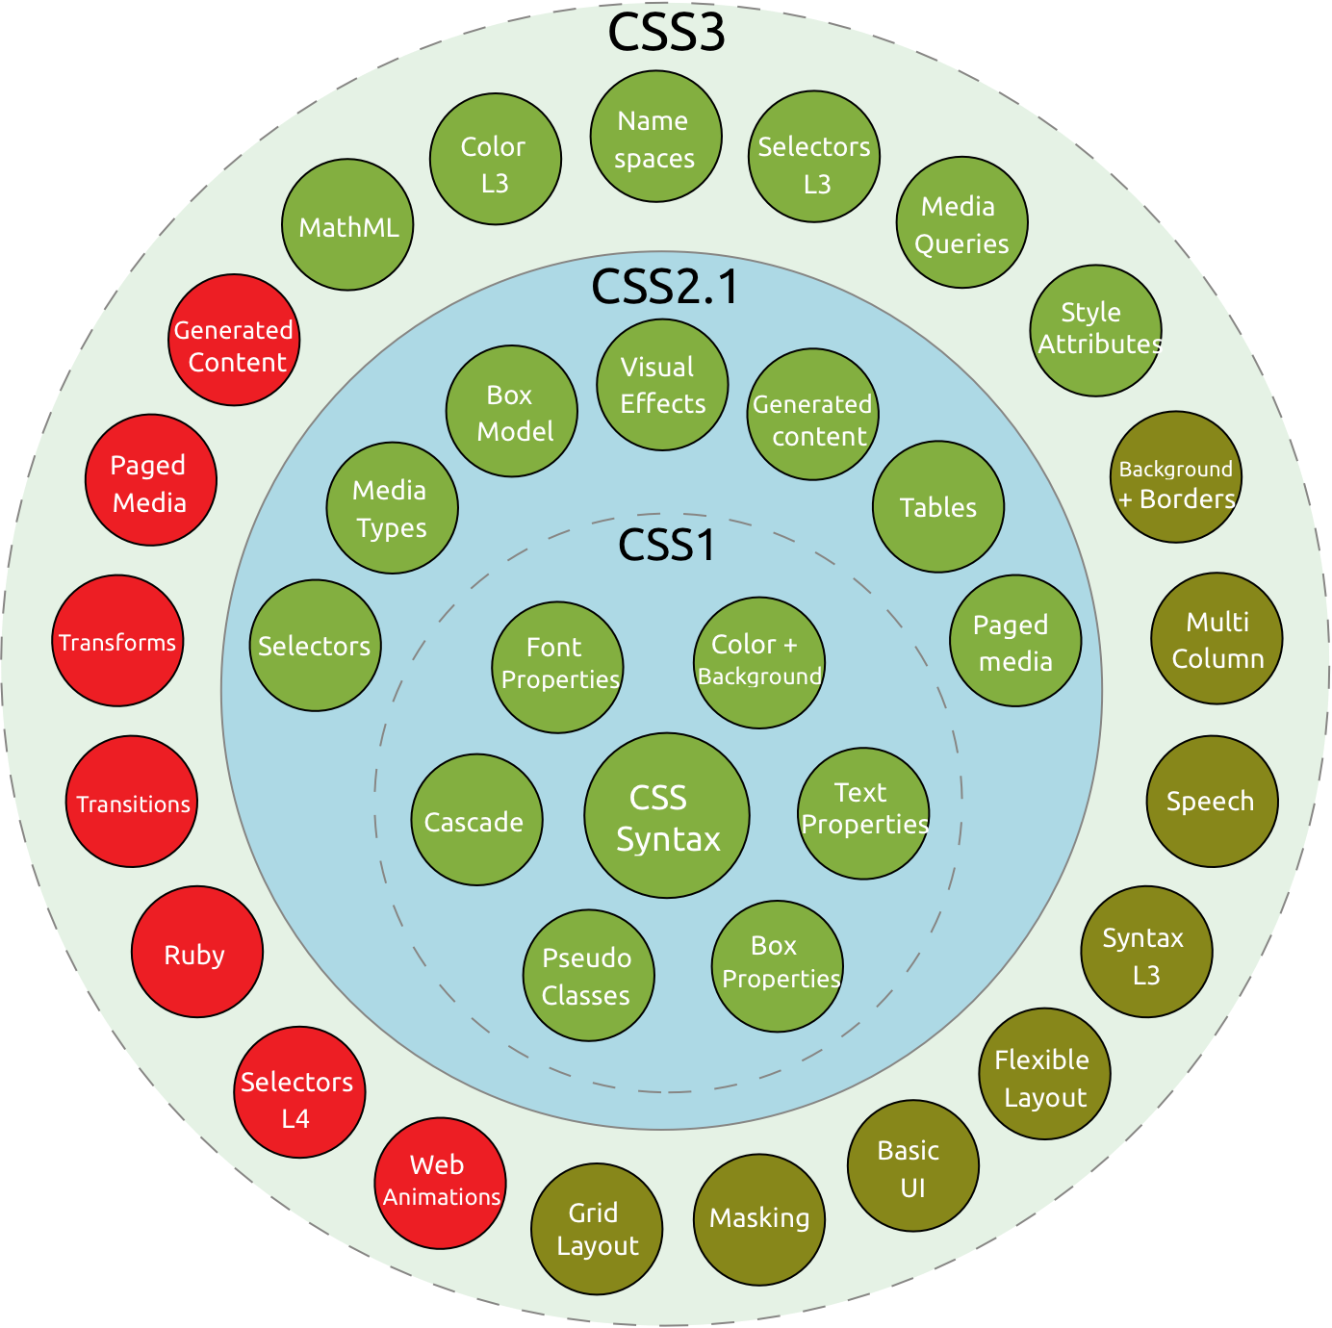
CSS – Cascading Style Sheets and Selectors
Introduction

Slide 5
CSS – Cascading Style Sheets and Selectors
Three ways to include CSS
Inline Style - CSS is placed directly into the XHTML element.
Internal Style Sheet - CSS is placed into a separate area within the <head> section of a web page.
External Style Sheet - CSS is placed into a separate file and "connected" to a web page.

Slide 6
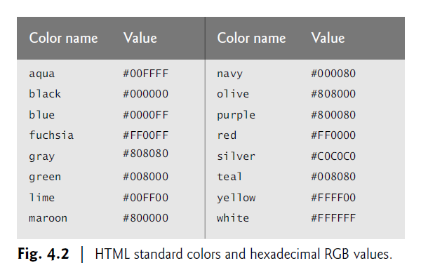
Inline Styles
We can declare document styles inline in the HTML5 markup, in embedded style sheets or in separate CSS files.
inline styles declare an individual element’s format using theHTML5 attribute style.
Inline styles override any other styles applied.
Two properties, font-size and color, separated by a semicolon.
Figure 4.2 contains the HTML standard color set.

Slide 7
CSS – Cascading Style Sheets and Selectors
Inline Style
Inline CSS is used to apply CSS in a single element. It can apply style uniquely in each element.
To apply inline CSS, you need to use style attribute within HTML element.
We can use as many properties as we want, but each property should be separated by a semicolon (;).
<!DOCTYPE html>
<html>
<body>
<h1 style="color:blue;">A Blue Heading</h1>
<p style="color:red;">A red paragraph.</p>
</body>
</html>

Slide 8
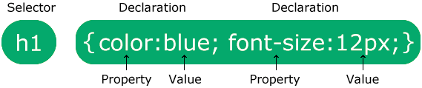
CSS – Cascading Style Sheets and Selectors
Three ways to include CSS
Internal CSS:
An Internal stylesheets contains the CSS properties for a webpage in <head> section of HTML document. To use Internal CSS, we can use class and id attributes.
We can use internal CSS to apply a style for a single HTML page.

Slide 9
CSS – Cascading Style Sheets and Selectors
Three ways to include CSS
Internal Style Sheet:Example
<!DOCTYPE html> <html> <head> <style> body {background-color: powderblue;} h1 {color: blue;} p {color: red;} </style> </head> <body> <h1>This is a heading</h1> <p>This is a paragraph.</p> </body> </html>

Slide 10
Setting Multiple Properties
We can define as many properties as we wish for a selector:
p {color:red;font-style:italic;text-align:center;}
In this example, all text within paragraph elements will show in red italics that is centered on the page.
p {
color: red;
font-style: italic;
text-align: center;
}
Just as with HTML, browsers ignore space characters in CSS code. Many designers take advantage of this fact by placing the opening and closing curly brackets on their own dedicated lines. Each of the property and value pairings are placed on their own indented line, with a space after the colon. This makes the code far easier to read.

Slide 11
CSS – Cascading Style Sheets and Selectors
Three ways to include CSS
External CSS:
An external CSS contains a separate CSS file which only contains style code using the class name, id name, tag name, etc. We can use this CSS file in any HTML file by including it in HTML file using <link> tag.
If we have multiple HTML pages for an application and which use similar CSS, then we can use external CSS.
There are two files need to create to apply external CSS
First, create the HTML file
Create a CSS file and save it using the .css extension (This file only will only contain the styling code.)
Link the CSS file in your HTML file using tag in header section of HTML document.

Slide 12
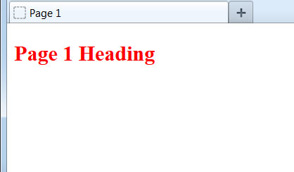

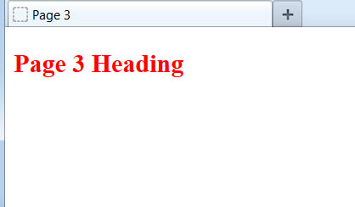
CSS – Cascading Style Sheets and Selectors
Benefits of External Style Sheets
The real power of using an external style sheet is that multiple web pages on our site can link to the same style sheet:
style.css :
h2 {color:red;}
page1.html
page2.html
page3.html
Styles declared in an external style sheet will affect all matching elements on all web pages that link to the style sheet. By editing the external style sheet, we can make site-wide changes (even to hundreds of pages) instantly.

Slide 13
CSS – Cascading Style Sheets and Selectors
Internal vs. External Style Sheets
Internal Style Sheets
are appropriate for very small sites, especially those that have just a single page.
might also make sense when each page of a site needs to have a completely different look.
External Style Sheets:
are better for multi-page websites that need to have a uniform look and feel to all pages.
make for faster-loading sites (less redundant code).
allow designers to make site-wide changes quickly and easily.
External style sheets create the furthest separation between content and presentation. Hence, the best option when creating a new site.

Slide 14
CSS – Cascading Style Sheets and Selectors
Three ways to include CSS
External CSS Example
<!DOCTYPE html> <html> <head> <link rel="stylesheet" href="styles.css"> </head> <body> <h1>This is a heading</h1> <p>This is a paragraph.</p> </body> </html>

Slide 15
CSS – Cascading Style Sheets and Selectors
Three ways to include CSS
The external style sheet can be written in any text editor. The file must not contain any HTML code, and must be saved with a .css extension.
Here is what the "styles.css" file looks like:
body { background-color: powderblue; } h1 { color: blue; } p { color: red; }

Slide 16
CSS – Cascading Style Sheets and Selectors
Conflicts
Same formatting rules can be defined in all three locations at the same time.
For example, a paragraph element could contain an inline style (color:red) but the internal style sheet (color:blue) and the external style sheet (color:green) give conflicting instructions to the web browser.
Web browsers need a consistent way of "settling" this disagreement.

Slide 17
CSS – Cascading Style Sheets and Selectors
Cascading in CSS
We use the term cascading because there is an established order of priority to resolve these formatting conflicts:
Inline style (highest priority)
Internal style sheet (second priority)
External style sheet (third priority)
Web browser default (only if not defined elsewhere)
For each XHTML element, the browser will check to see which inline styles are defined, then those styles in the internal style sheet, and finally those styles in the external sheet. For all conflicts, it will use this priority system to determine which format to display on the page.
In the prior example, the paragraph would display as red, because the inline style "outranks" all the others.

Slide 18
CSS – Cascading Style Sheets and Selectors
Cascading in CSS
We use the term cascading because there is an established order of priority to resolve these formatting conflicts:
Inline style (highest priority)
Internal style sheet (second priority)
External style sheet (third priority)
Web browser default (only if not defined elsewhere)
For each XHTML element, the browser will combine all the styles defined at different levels. For all conflicts, it will use the above priority system to determine which format to display on the page.
In the prior example, the paragraph would display as red, because the inline style "outranks" all the others.

Slide 19
CSS – Cascading Style Sheets and Selectors
How the browser handles styling?
A web browser will process all CSS code it encounters, even if it is from all three methods.
For example, an external style sheet could define the font of a heading, an internal style sheet could specify the font size of the heading, and an inline style could italicize the heading. All three would be applied.
Sometimes a browser will receive conflicting instructions from the CSS code. For example, what if each of the above CSS sources specified a different color for the heading text?
Browsers need a consistent way of settling these formatting conflicts in a consistent fashion. That is where the "cascade" of cascading style sheets comes into effect.

Slide 20
CSS – Cascading Style Sheets and Selectors
Commonly used CSS Property
background-color | background-color:red; | It defines the background color of that element.
color | color: lightgreen; | It defines the color of text of an element
padding | padding: 20px; | It defines the space between content and the border.
margin | margin: 30px; margin-left: | It creates space around an element.
font-family | font-family: cursive; | Font-family defines a font for a particular element.
Font-size | font-size: 50px; | Font-size defines a font size for a particular element.
text-align | text-align: left; | It is used to align the text in a selected position.

Slide 21

CSS Selectors
Select the Elements to Apply CSS Rules

Slide 22
CSS – Cascading Style Sheets and Selectors
Selectors in CSS
The selector points to the HTML element you want to style.
The declaration block contains one or more declarations separated by semicolons.
Each declaration includes a CSS property name and a value, separated by a colon.
Multiple CSS declarations are separated with semicolons, and declaration blocks are surrounded by curly braces.
CSS selectors are used to "find" (or select) the HTML elements you want to style.

Slide 23
CSS – Cascading Style Sheets and Selectors
Selectors in CSS
We can divide CSS selectors into five categories:
CSS Element Selector
CSS Id Selector
CSS Class Selector
CSS Universal Selector
CSS Group Selector

Slide 24
CSS – Cascading Style Sheets and Selectors
Selectors in CSS
1. The element selector selects HTML elements based on the element name.
Ex:p { text-align: center; color: red; }

Slide 25
CSS – Cascading Style Sheets and Selectors
Selectors in CSS
2. The CSS id Selector
The id selector uses the id attribute of an HTML element to select a specific element.
The id of an element is unique within a page, so the id selector is used to select one unique element!
To select an element with a specific id, write a hash (#) character, followed by the id of the element.

Slide 26
CSS – Cascading Style Sheets and Selectors
Selectors in CSS
<!DOCTYPE html>
<html>
<head>
<style>
#para1 {
text-align: center;
color: red;
}
</style>
</head>
<body>
<p id="para1">Hello World!</p>
<p>This paragraph is not affected by the style.</p>
</body>
</html>

Slide 27
CSS – Cascading Style Sheets and Selectors
Selectors in CSS
3.The CSS class Selector
The class selector selects HTML elements with a specific class attribute.
To select elements with a specific class, write a period (.) character, followed by the class name.

Slide 28
CSS – Cascading Style Sheets and Selectors
Selectors in CSS
<html>
<head>
<style>
.center {
text-align: center;
color: red;
}
</style>
</head>
<body>
<h1 class="center">Red and center-aligned heading</h1>
<p class="center">Red and center-aligned paragraph.</p>
</body>
</html>

Slide 29
CSS – Cascading Style Sheets and Selectors
Selectors in CSS
4.The CSS Universal Selector: The universal selector (*) selects all HTML elements on the page.
<!DOCTYPE html>
<html>
<head>
<style>
* {
text-align: center;
color: blue;
}
</style>
</head>
<body>
<h1>Hello world!</h1>
<p>Every element on the page will be affected by the style.</p>
<p id="para1">Me too!</p>
<p>And me!</p>
</body></html>

Slide 30
CSS – Cascading Style Sheets and Selectors
Selectors in CSS
5.The CSS Grouping Selector
The grouping selector selects all the HTML elements with the same style definitions.
Look at the following CSS code (the h1, h2, and p elements have the same style definitions):
It will be better to group the selectors, to minimize the code.
To group selectors, separate each selector with a comma.
h1, h2, p { text-align: center; color: red; }

Slide 31
CSS – Cascading Style Sheets and Selectors
Selectors in CSS
CSS Combinators
A combinator is something that explains the relationship between the selectors.
Descendant Selector
The descendant selector matches all elements that are descendants of a specified element.
The following example selects all <p> elements inside <div> elements:

Slide 32
CSS – Cascading Style Sheets and Selectors
Selectors in CSS
<head>
<style>
div p {
background-color: yellow;
}
</style>
</head>
<body>
<h2>Descendant Selector</h2>
<p>The descendant selector matches all elements that are descendants of a specified element.</p>
<div>
<p>Paragraph 1 in the div.</p>
<p>Paragraph 2 in the div.</p>
<section><p>Paragraph 3 in the div.</p></section>
</div>
<p>Paragraph 4. Not in a div.</p>
<p>Paragraph 5. Not in a div.</p>
</body>
</html>

Slide 33
CSS – Cascading Style Sheets and Selectors
Selectors in CSS
The child selector selects all elements that are the children of a specified element.
The following example selects all <p> elements that are children of a <div> element:

Slide 34
CSS – Cascading Style Sheets and Selectors
Selectors in CSS
<html>
<head>
<style>
div > p {
background-color: yellow;
}
</style>
</head>
<body>
<h2>Child Selector</h2>
<p>The child selector (>) selects all elements that are the children of a specified element.</p>

Slide 35
CSS – Cascading Style Sheets and Selectors
Selectors in CSS
<div>
<p>Paragraph 1 in the div.</p>
<p>Paragraph 2 in the div.</p>
<section>
<!-- not Child but Descendant -->
<p>Paragraph 3 in the div (inside a section element).</p>
</section>
<p>Paragraph 4 in the div.</p>
</div>
<p>Paragraph 5. Not in a div.</p>
<p>Paragraph 6. Not in a div.</p>
</body>
</html>

Slide 36
CSS – Cascading Style Sheets and Selectors
Borders in CSS
The border-style property specifies what kind of border to display.
The following values are allowed:
dotted - Defines a dotted border
dashed - Defines a dashed border
solid - Defines a solid border
double - Defines a double border

Slide 37
CSS – Cascading Style Sheets and Selectors
Borders in CSS
<html>
<head>
<style>
div {
border: 1px solid black;
margin-top: 100px;
margin-bottom: 100px;
margin-right: 150px;
margin-left: 80px;
background-color: lightblue;
}
</style>
</head>
<body>
<h2>Using individual margin properties</h2>
<div>This div element has a top margin of 100px, a right margin of 150px, a bottom margin of 100px, and a left margin of 80px.</div>
</body>
</html>

Slide 38
CSS – Cascading Style Sheets and Selectors
Padding in CSS
Padding is used to create space around an element's content, inside of any defined borders.
div { padding-top: 50px; padding-right: 30px; padding-bottom: 50px; padding-left: 80px; }

Slide 39
CSS – Cascading Style Sheets and Selectors
<div> in HTML
The <div> tag defines a division or a section in an HTML document.
The <div> tag is used as a container for HTML elements –
which is then styled with CSS or manipulated with JavaScript.
The <div> tag is easily styled by using the class or id attribute.
Any sort of content can be put inside the <div> tag!
Note: By default, browsers always place a line break before
and after the <div> element.

Slide 40
CSS – Cascading Style Sheets and Selectors
Div tag in HTML
<html>
<html>
<head>
<style>
div {
display: block;
}
</style>
</head>
<body>
A div element is displayed like this:
<div>This is some text in a div element.</div>
Change the default CSS settings to see the effect.
</body>
</html>

Slide 41
CSS – Cascading Style Sheets and Selectors
div tag
div { height: 200px; width: 50%; background-color: powderblue; }
For example, a three-paragraph article may be enclosed in a div, and a navigation menu containing links might be enclosed in another div. Using divs this way makes it easier to identify different sections of a page and apply styling to them with CSS.

Slide 42
CSS – Cascading Style Sheets and Selectors
Height and Width in CSS
span
The span element is a generic inline element, typically used to apply styling to a portion of inline content.
An inline element does not start a new line and only takes up as much space on the page as its content.
Span tags are used on small segments of text, links, images, and other HTML elements that appear inline with the surrounding content.

Slide 43
CSS – Cascading Style Sheets and Selectors
Span tag
<!DOCTYPE html>
<html>
<body>
<h1>The span element</h1>
<p>My mother has <span style="color:blue;font-weight:bold">blue</span> eyes and my father has <span style="color:darkolivegreen;font-weight:bold">dark green</span> eyes.</p>
</body>
</html>

Slide 44
CSS – Cascading Style Sheets and Selectors
Selectors in CSS
Different List Item Markers
The list-style-type property specifies the type of list item marker.
The following example shows some of the available list item markers:
Example
ul.a {
list-style-type: circle;
}
ul.b {
list-style-type: square;
}
ol.c {
list-style-type: upper-roman;
}
ol.d {
list-style-type: lower-alpha;
}

Slide 45
THANK YOU
Vinay Joshi
Department of Computer Science and Engineering
vinayj@pes.edu
+91 80 2672 6622

